Slide 1
St Joseph & St James’s PS Poyntzpass
Class of 2020

Slide 2
September 2013 Primary 1 The journey began…

Slide 3
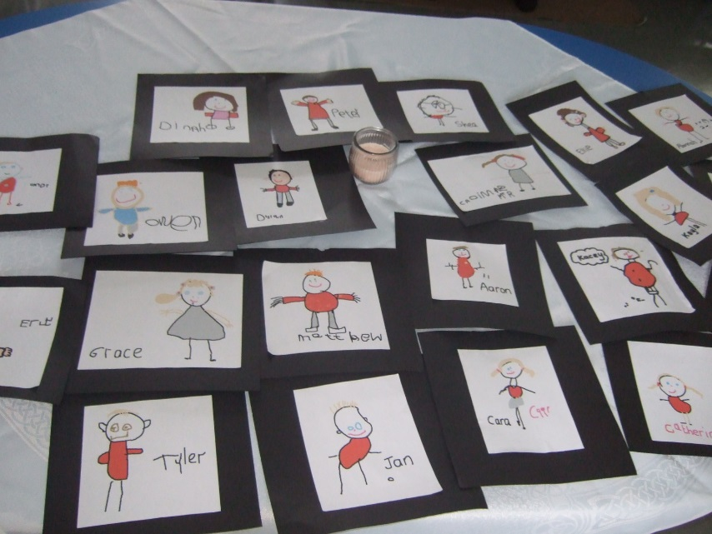
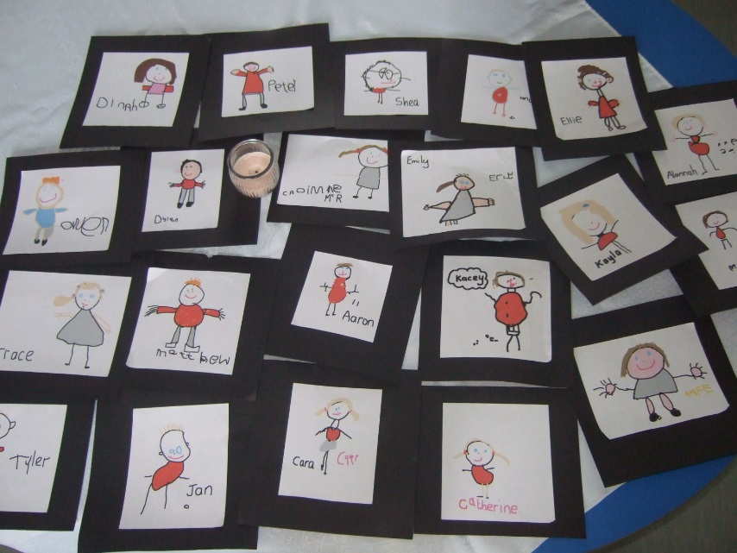
Primary 1 Welcome Service

Slide 4
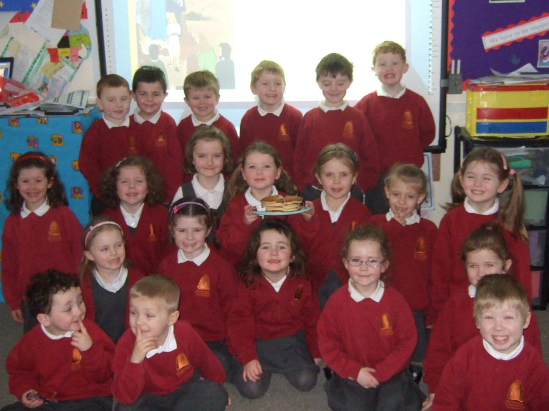

Slide 5
Primary 1 World Book Day

Slide 6
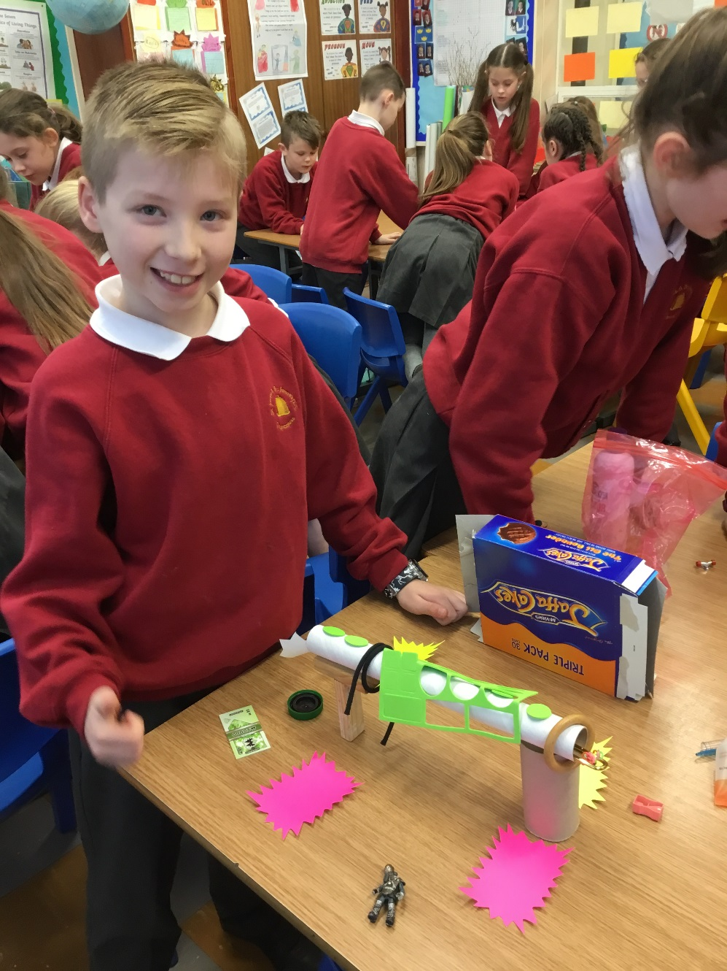
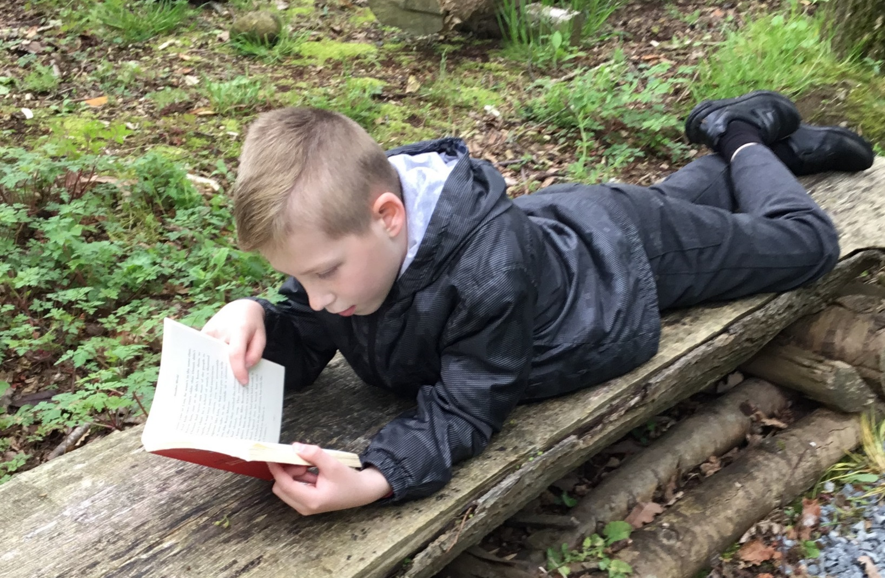

Slide 7
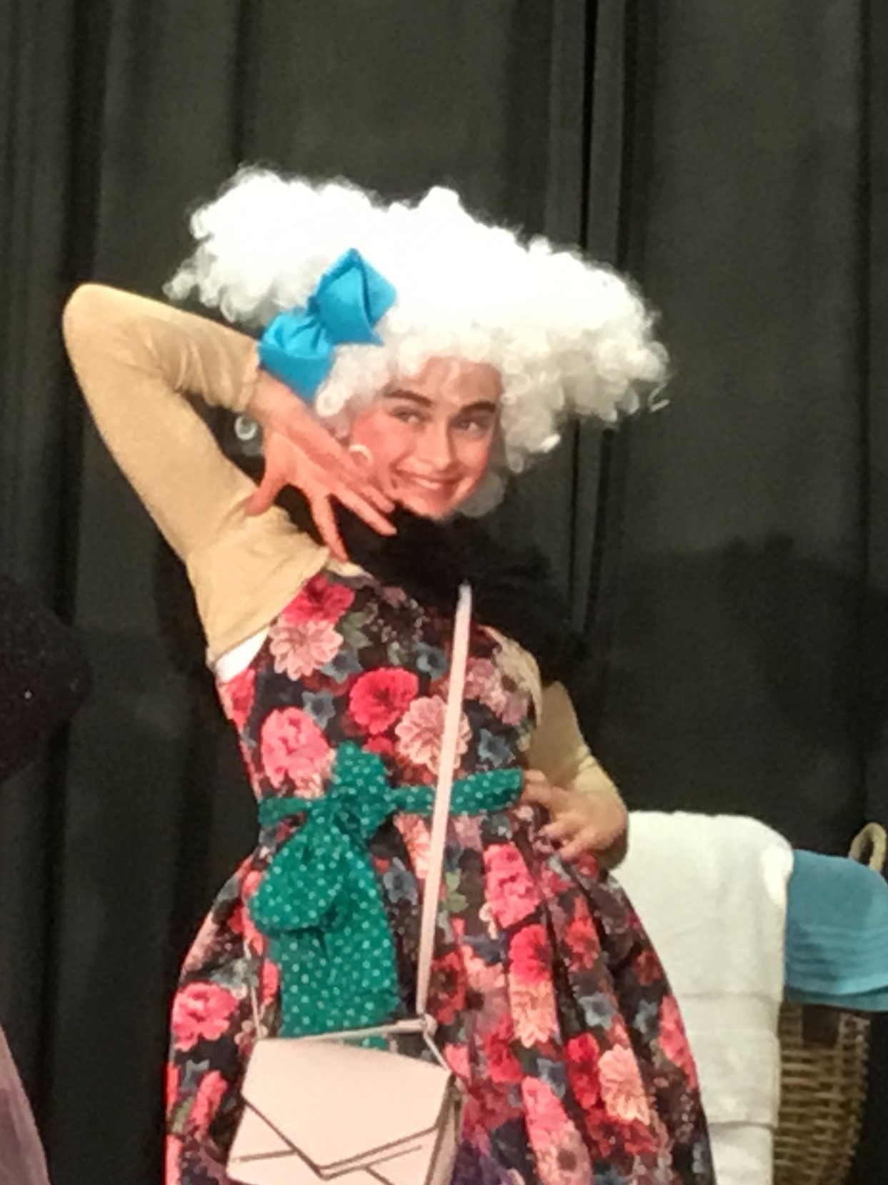
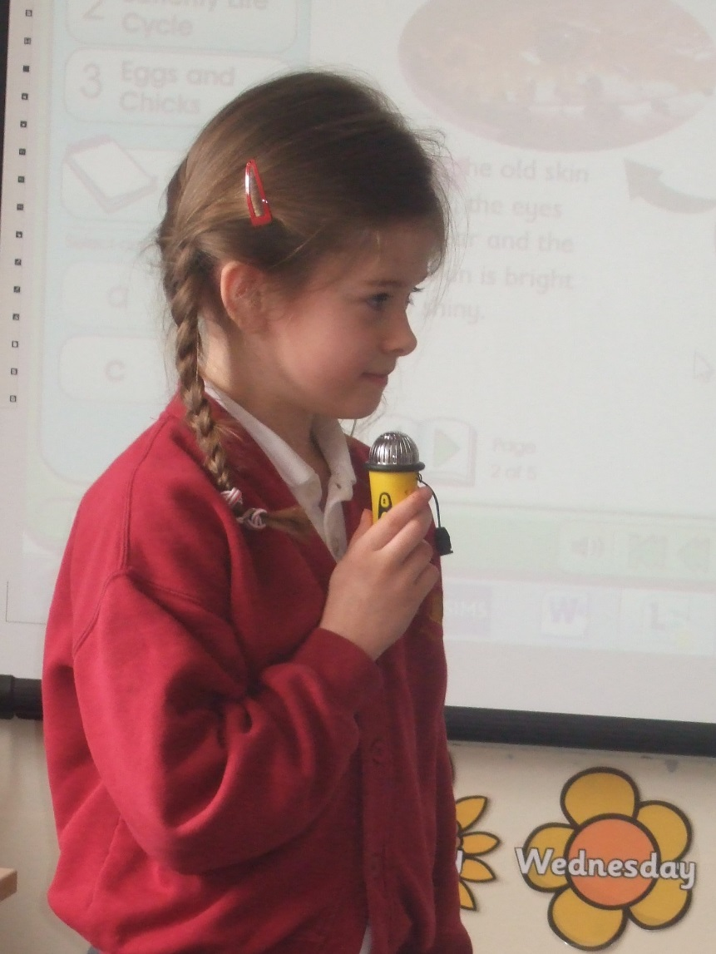
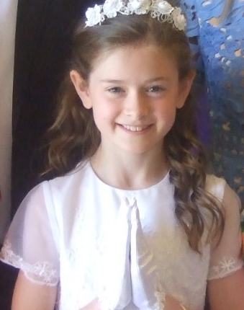

Slide 8
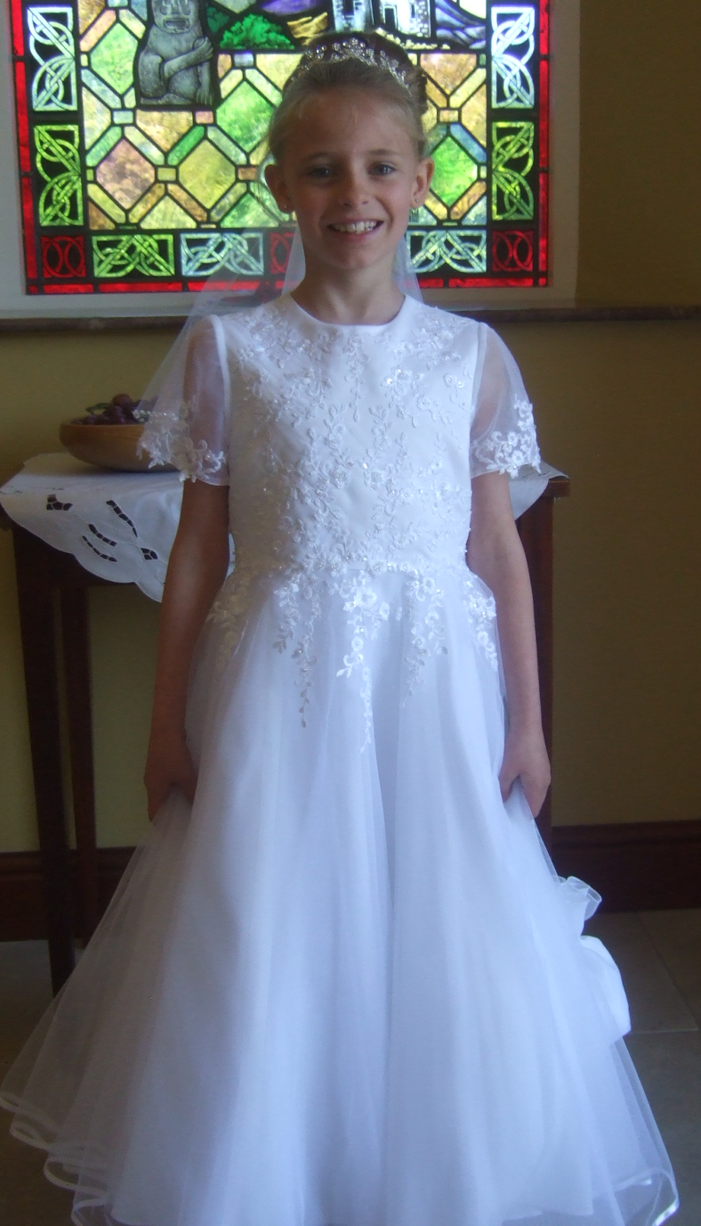
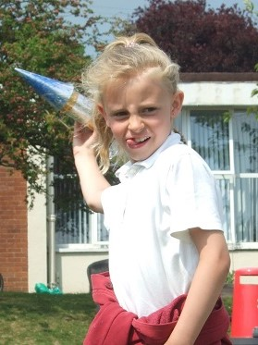
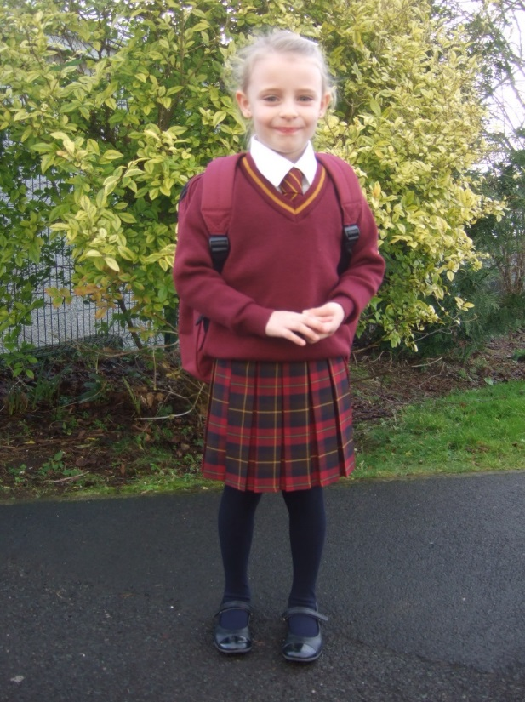

Slide 9
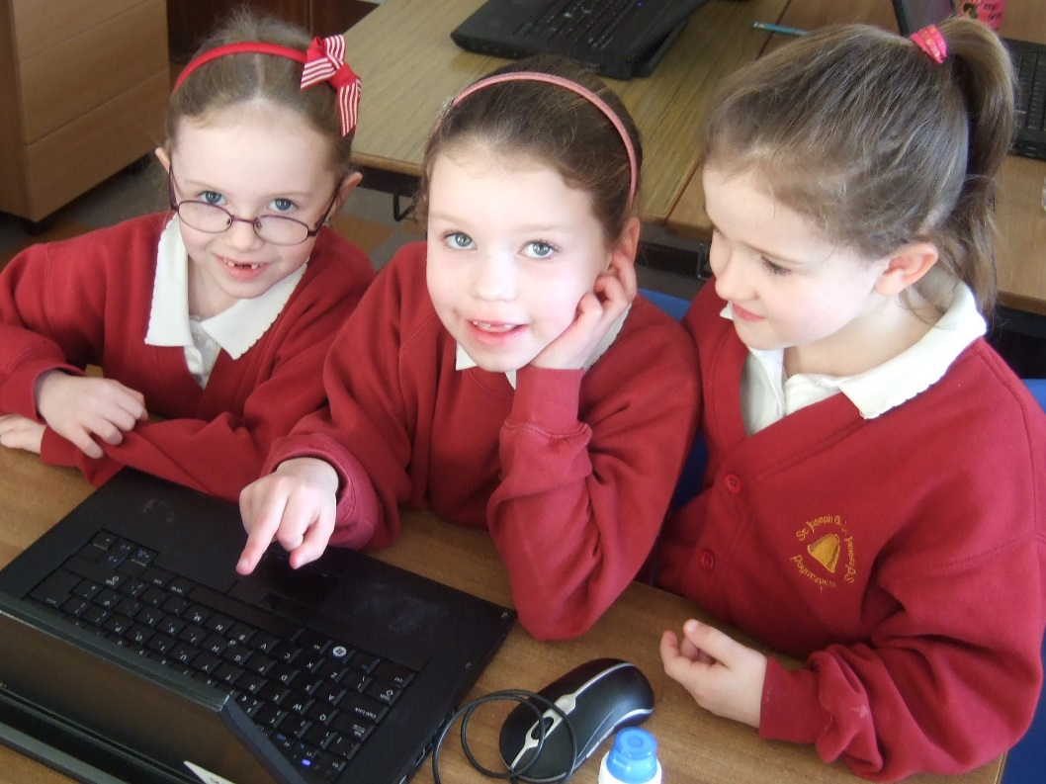
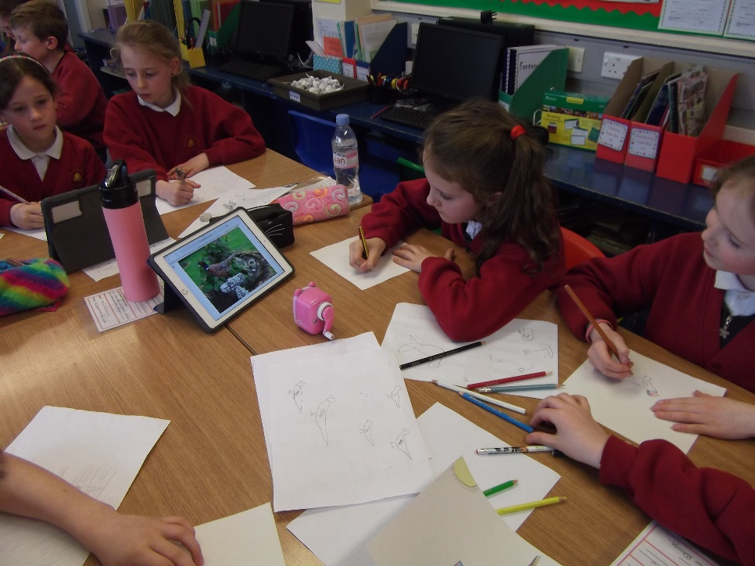
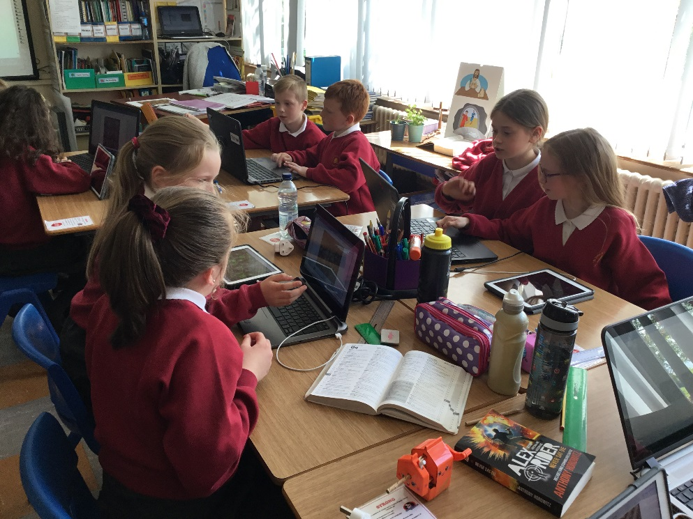
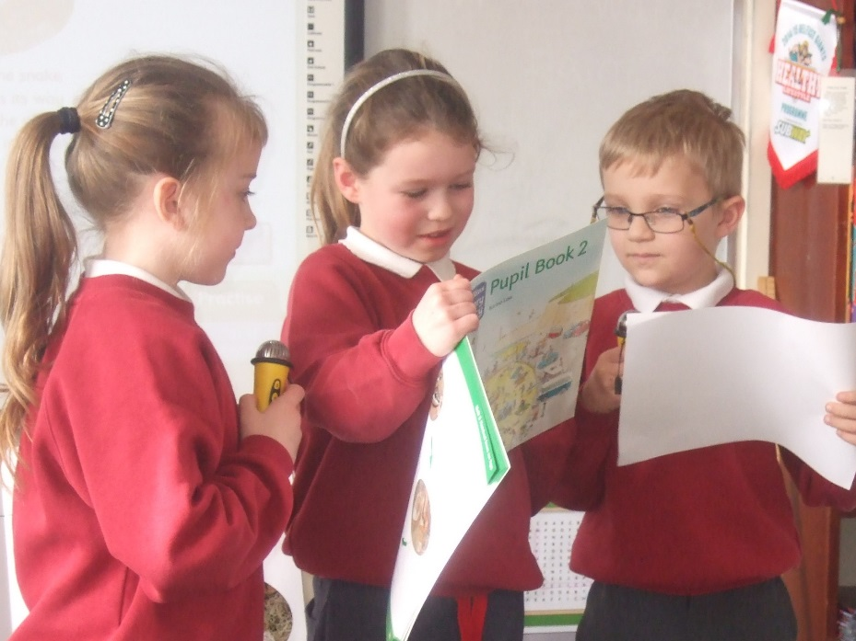
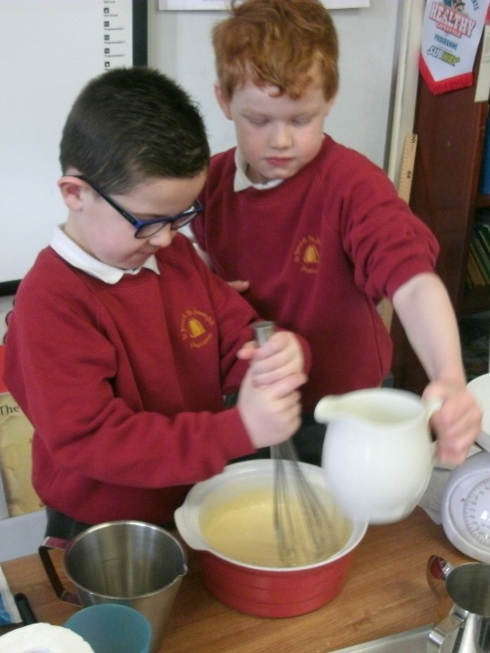
Many days we worked hard indoors…

Slide 10
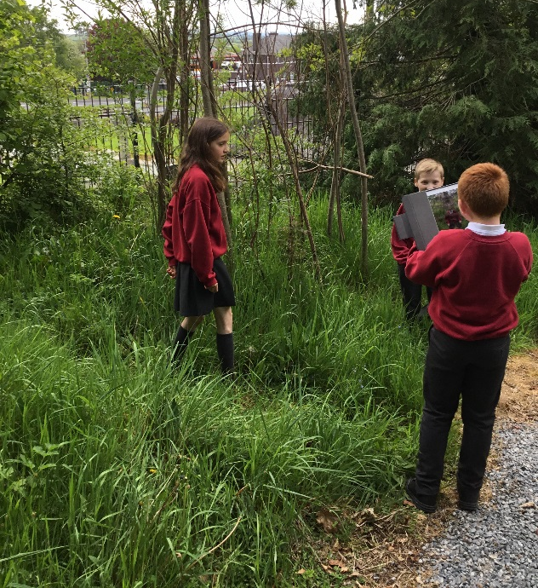
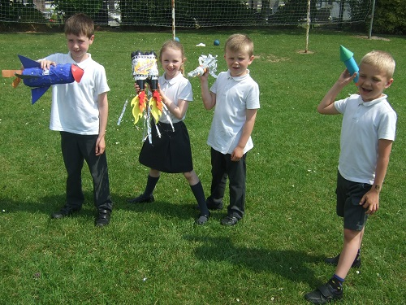
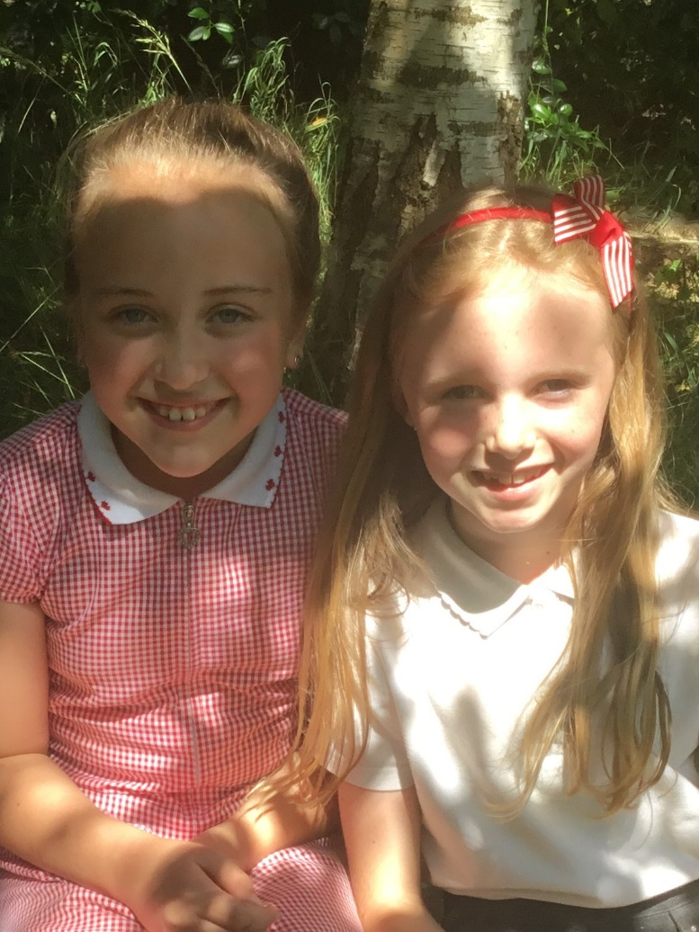
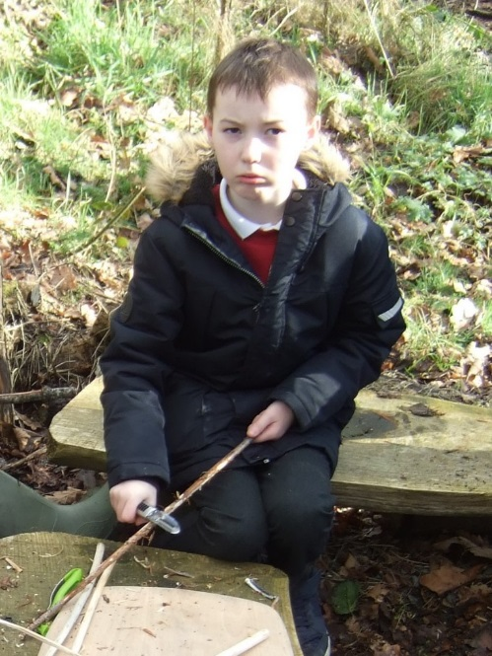
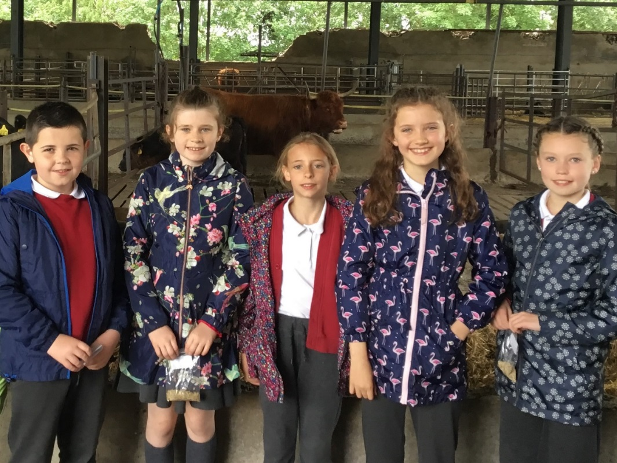
But learning outdoors was fun too….

Slide 11
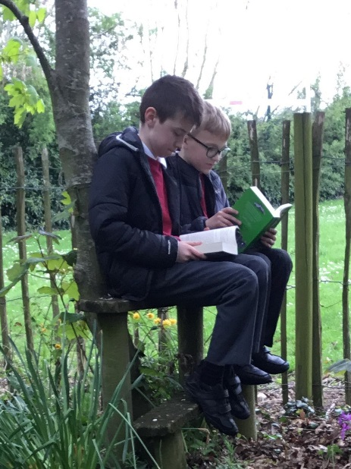
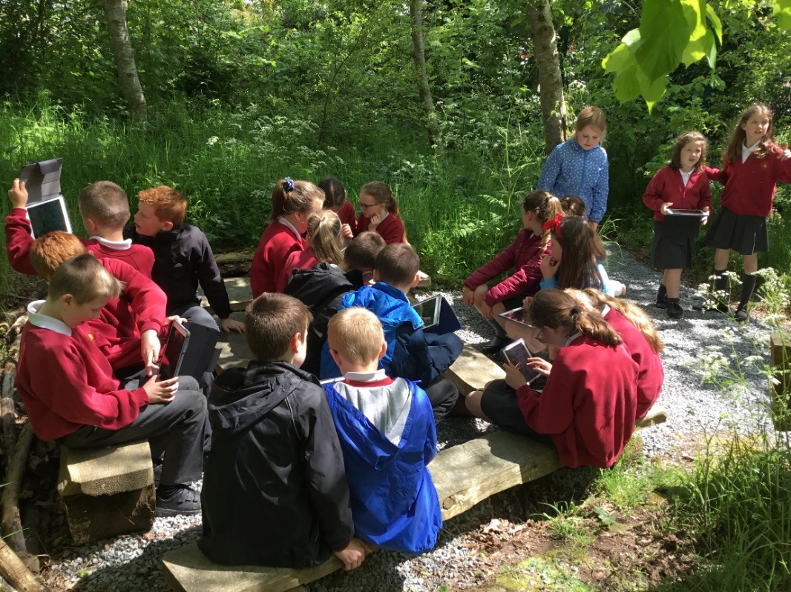
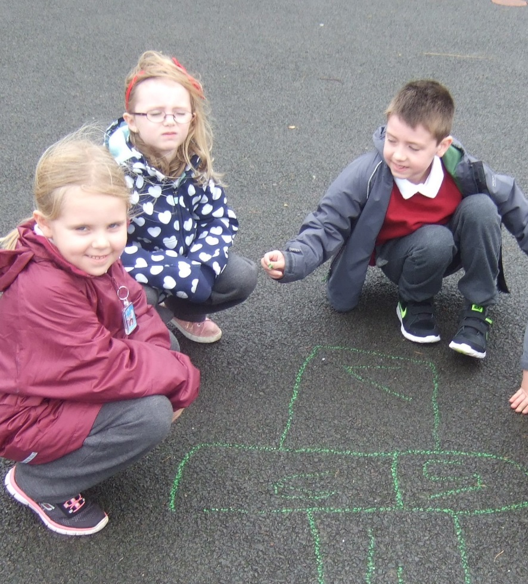
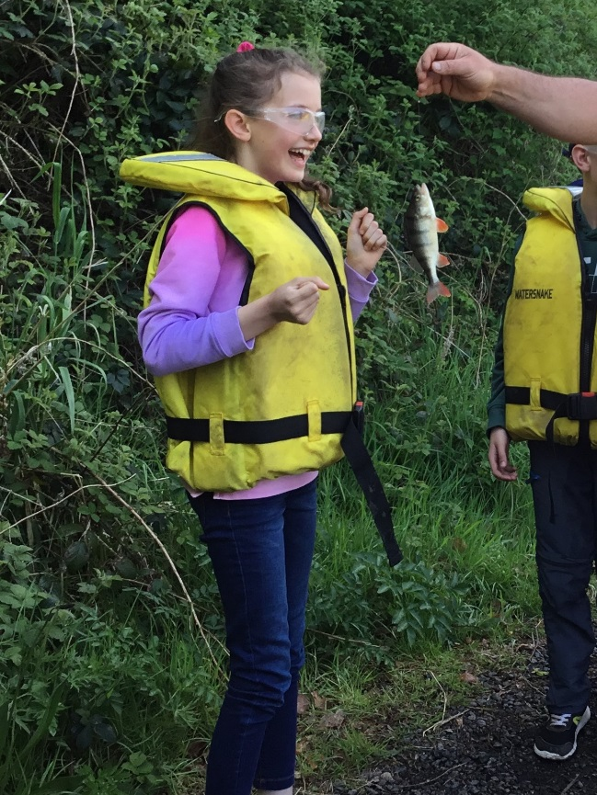
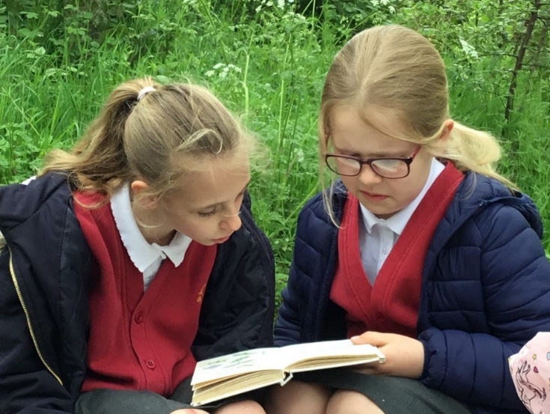
Lots of different things to be done….

Slide 12
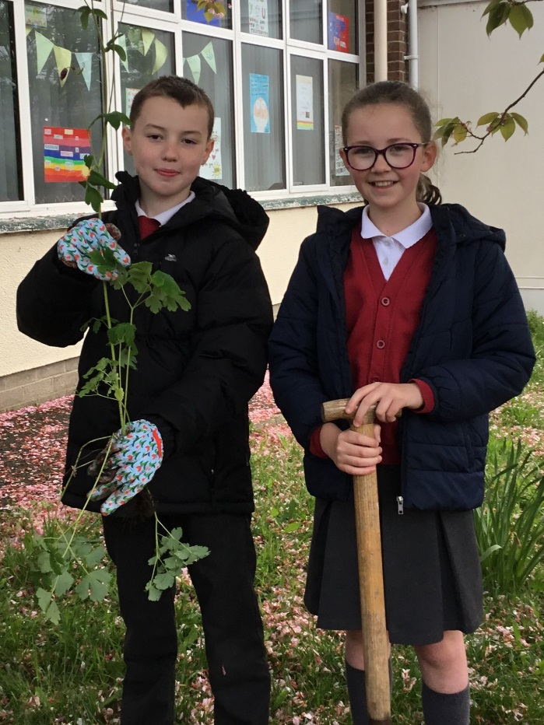
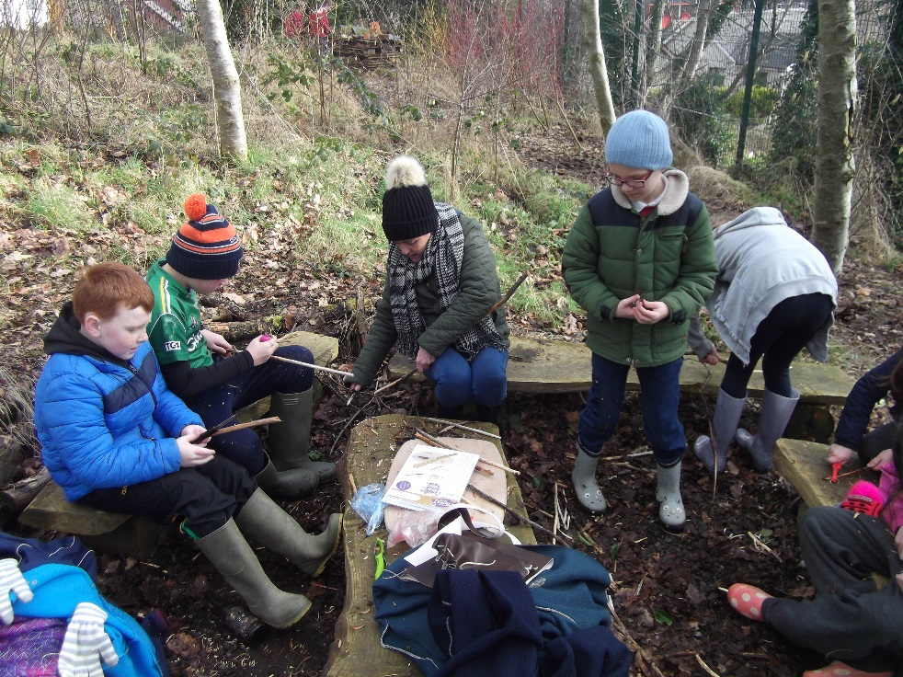
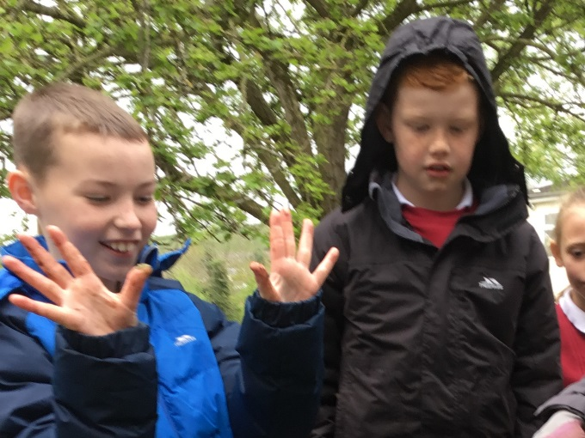
Still outside -
-time to get our hands dirty!

Slide 13
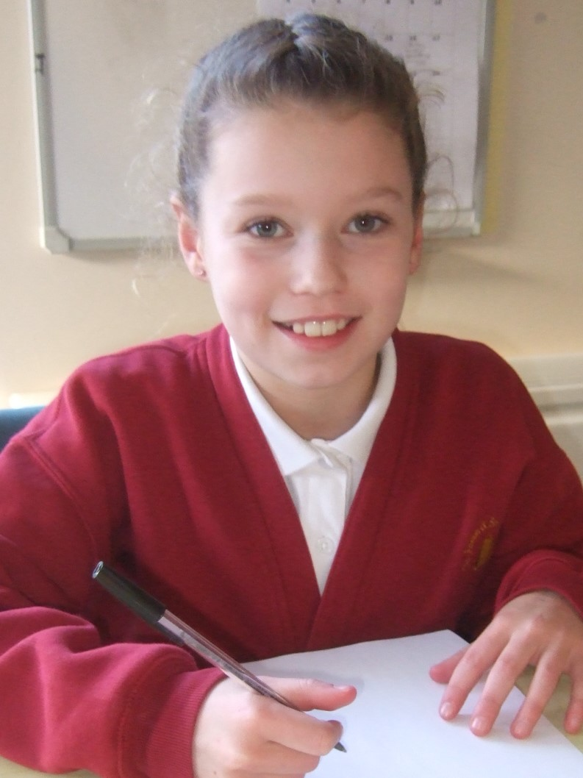
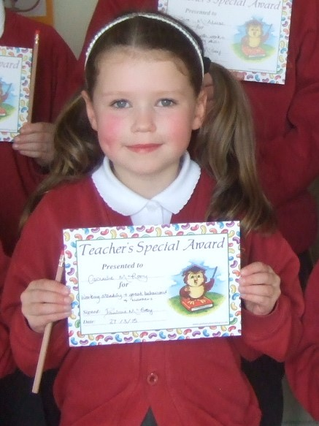

Slide 14
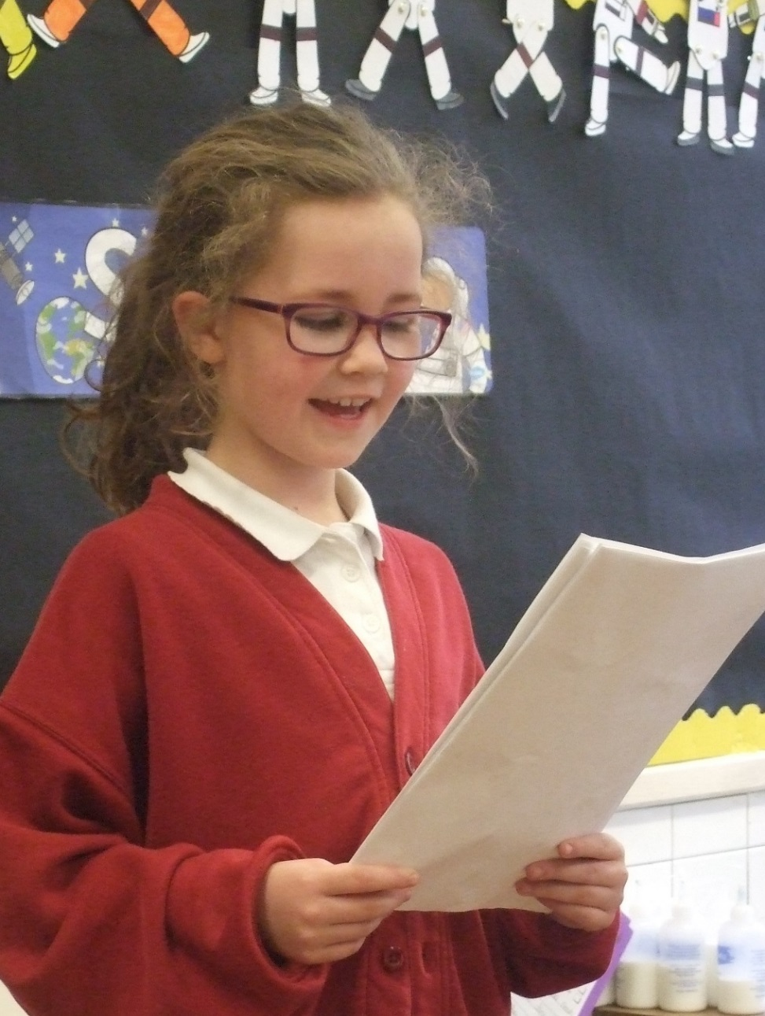
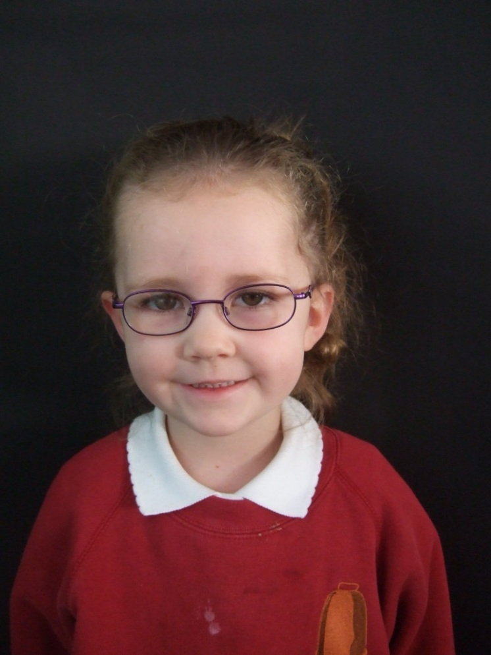

Slide 15
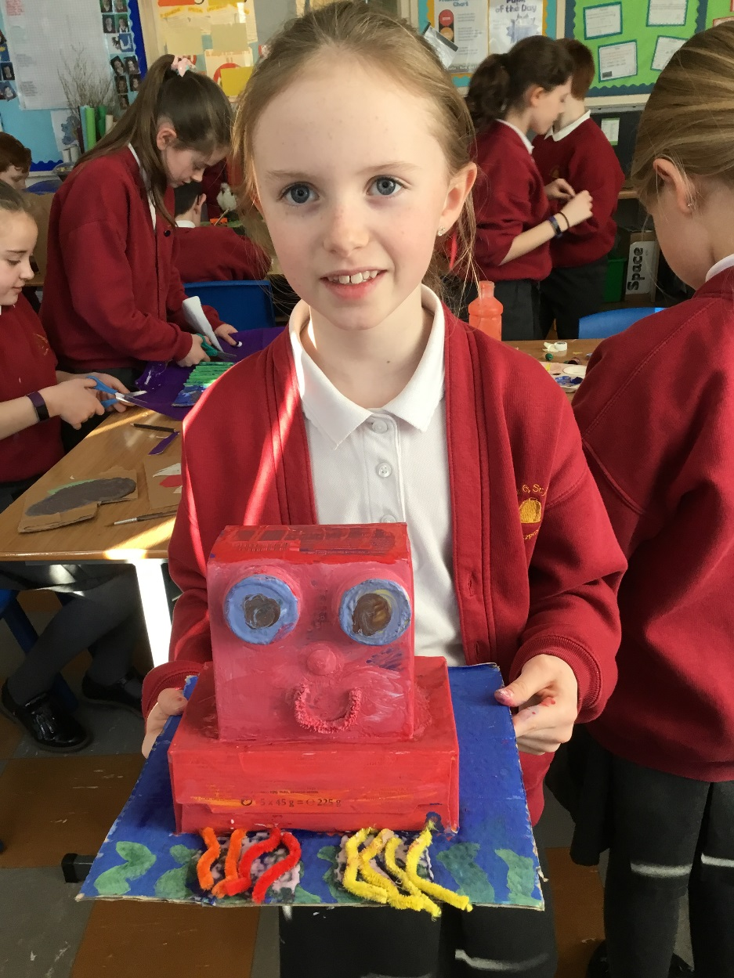
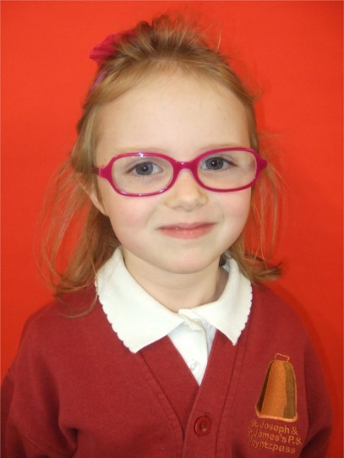
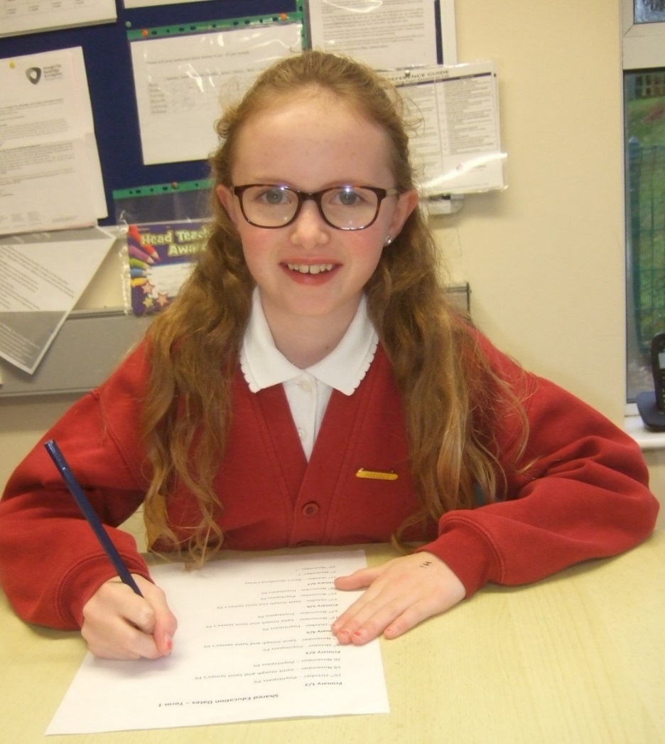

Slide 16
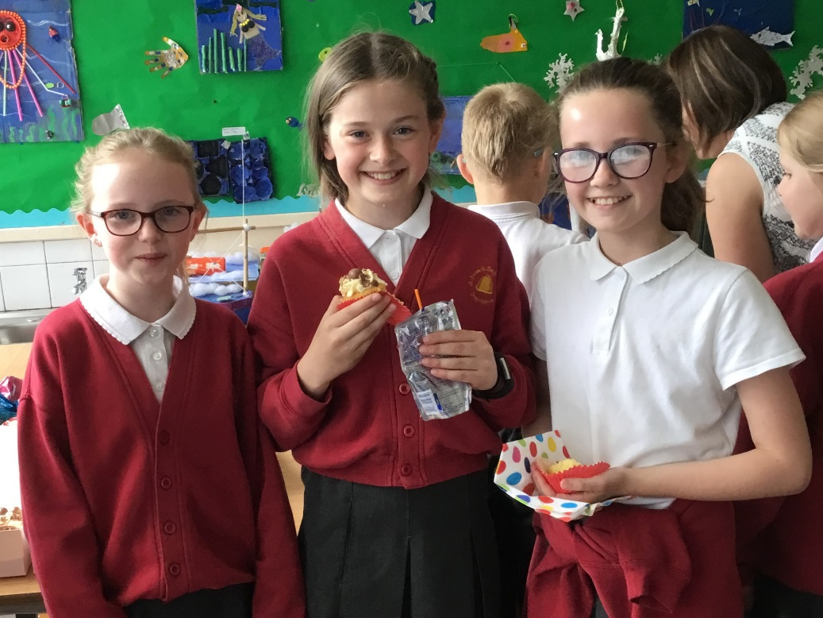
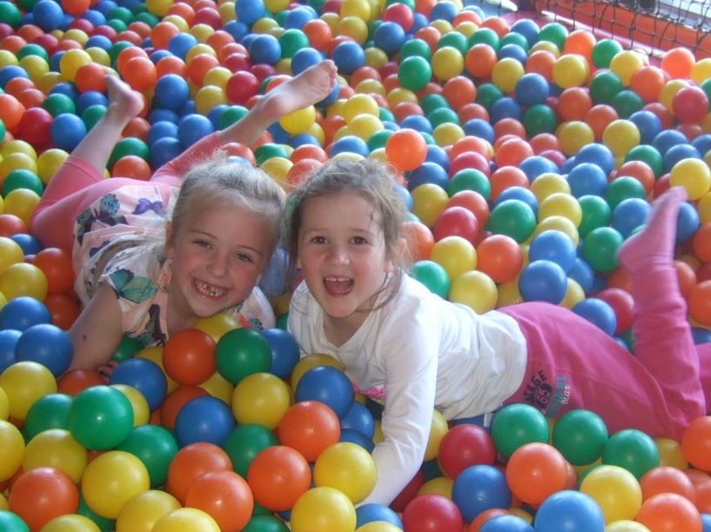
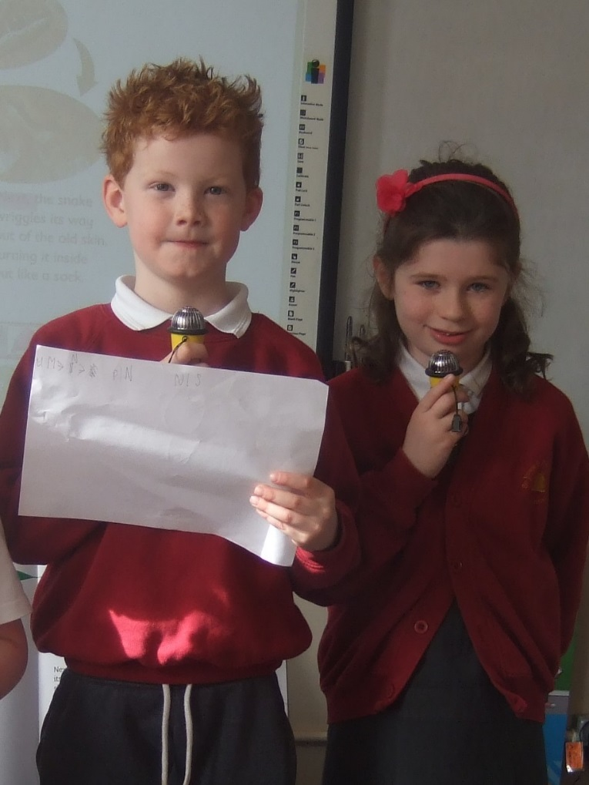
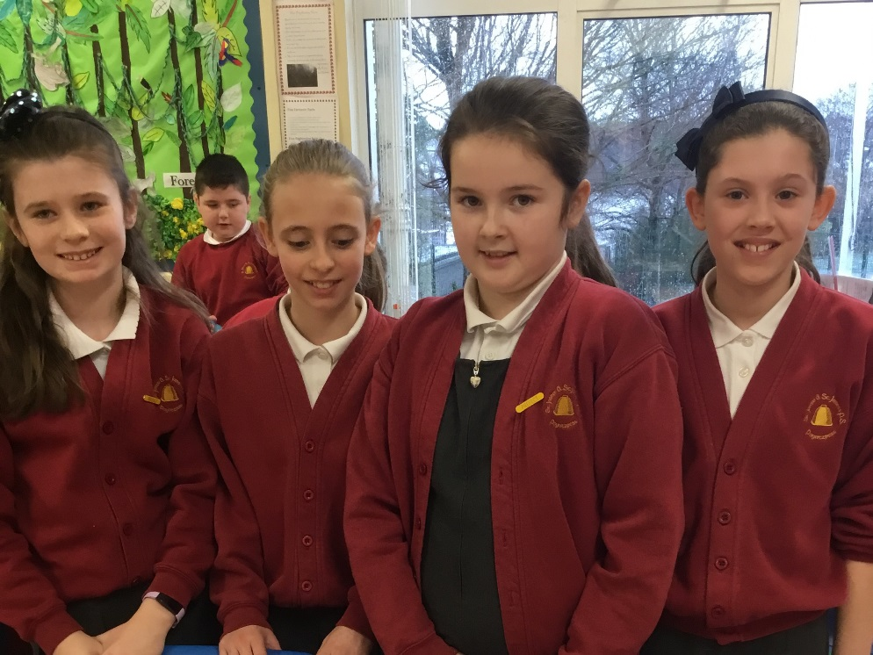
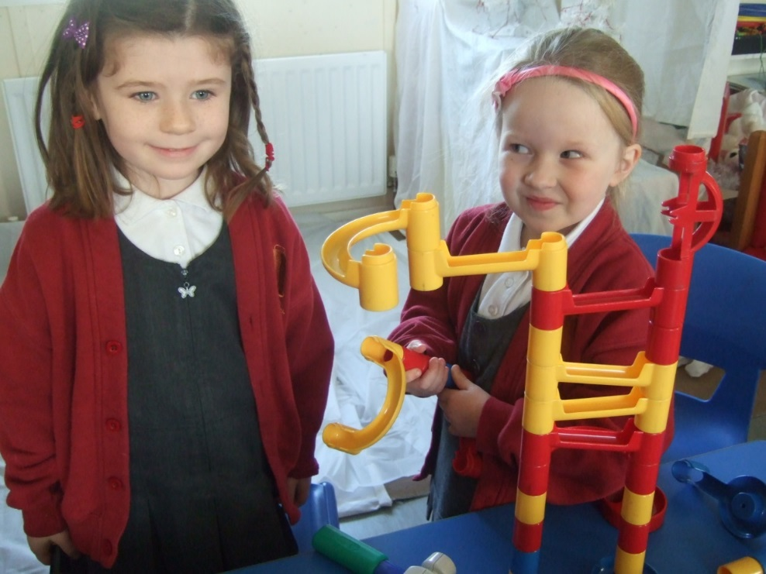
Building friendships..

Slide 17
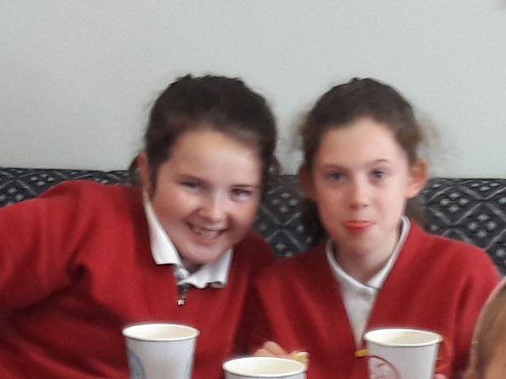
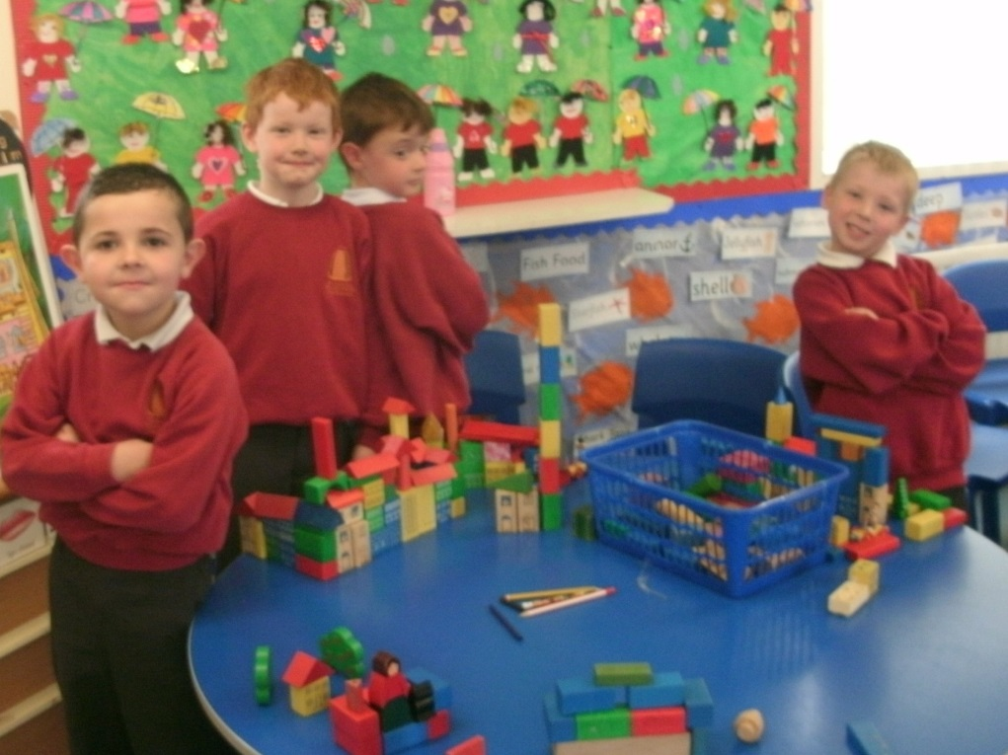
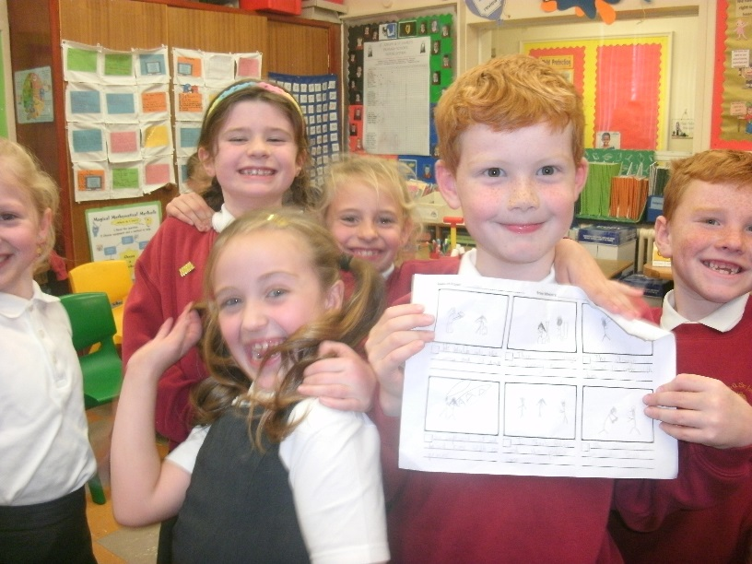
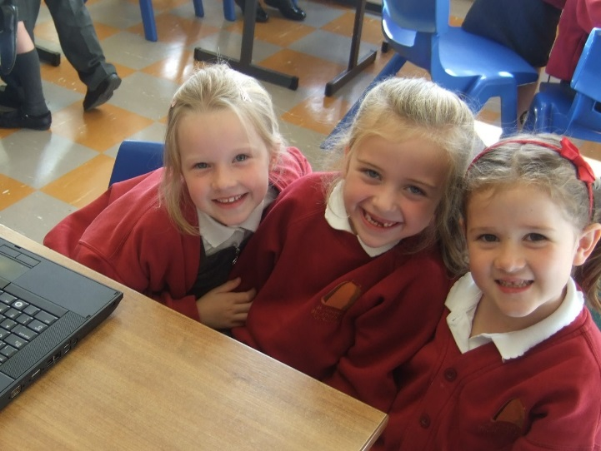
…that could last forever!

Slide 18
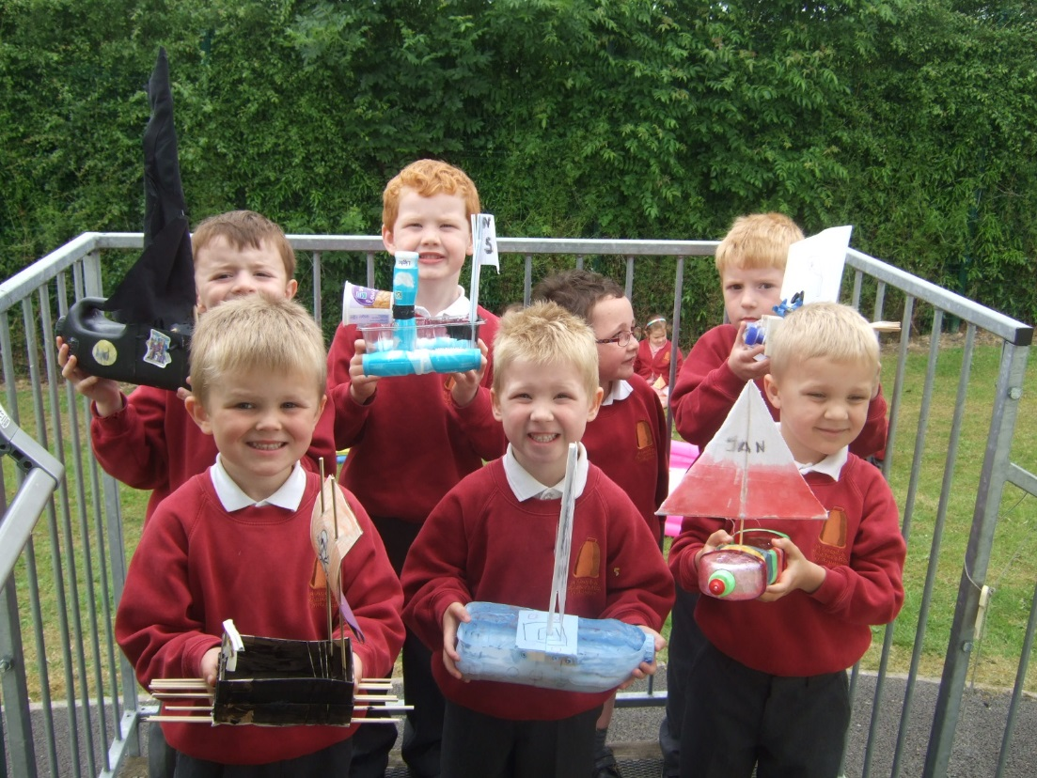
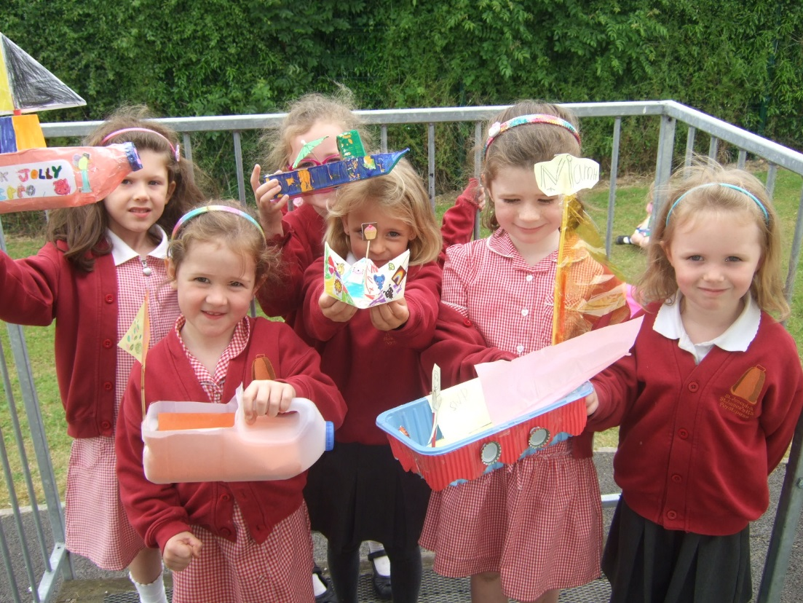
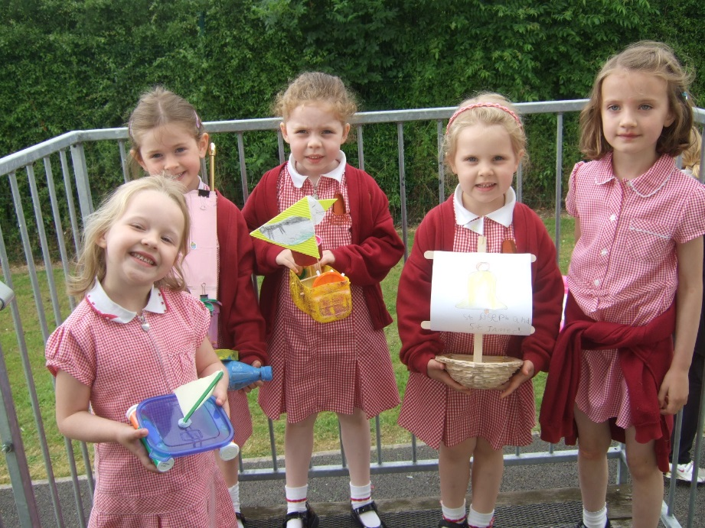
Building boats!

Slide 19
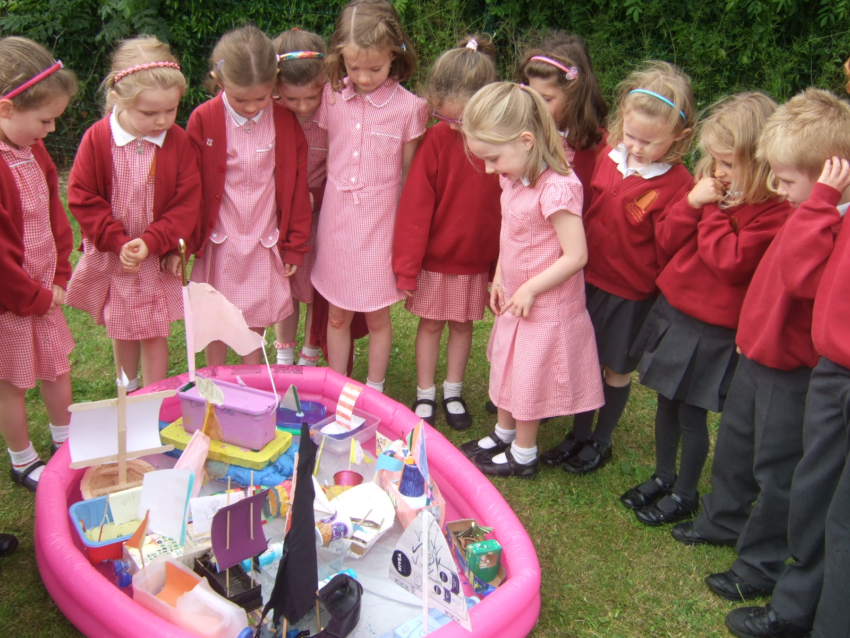
But will they all float?

Slide 20
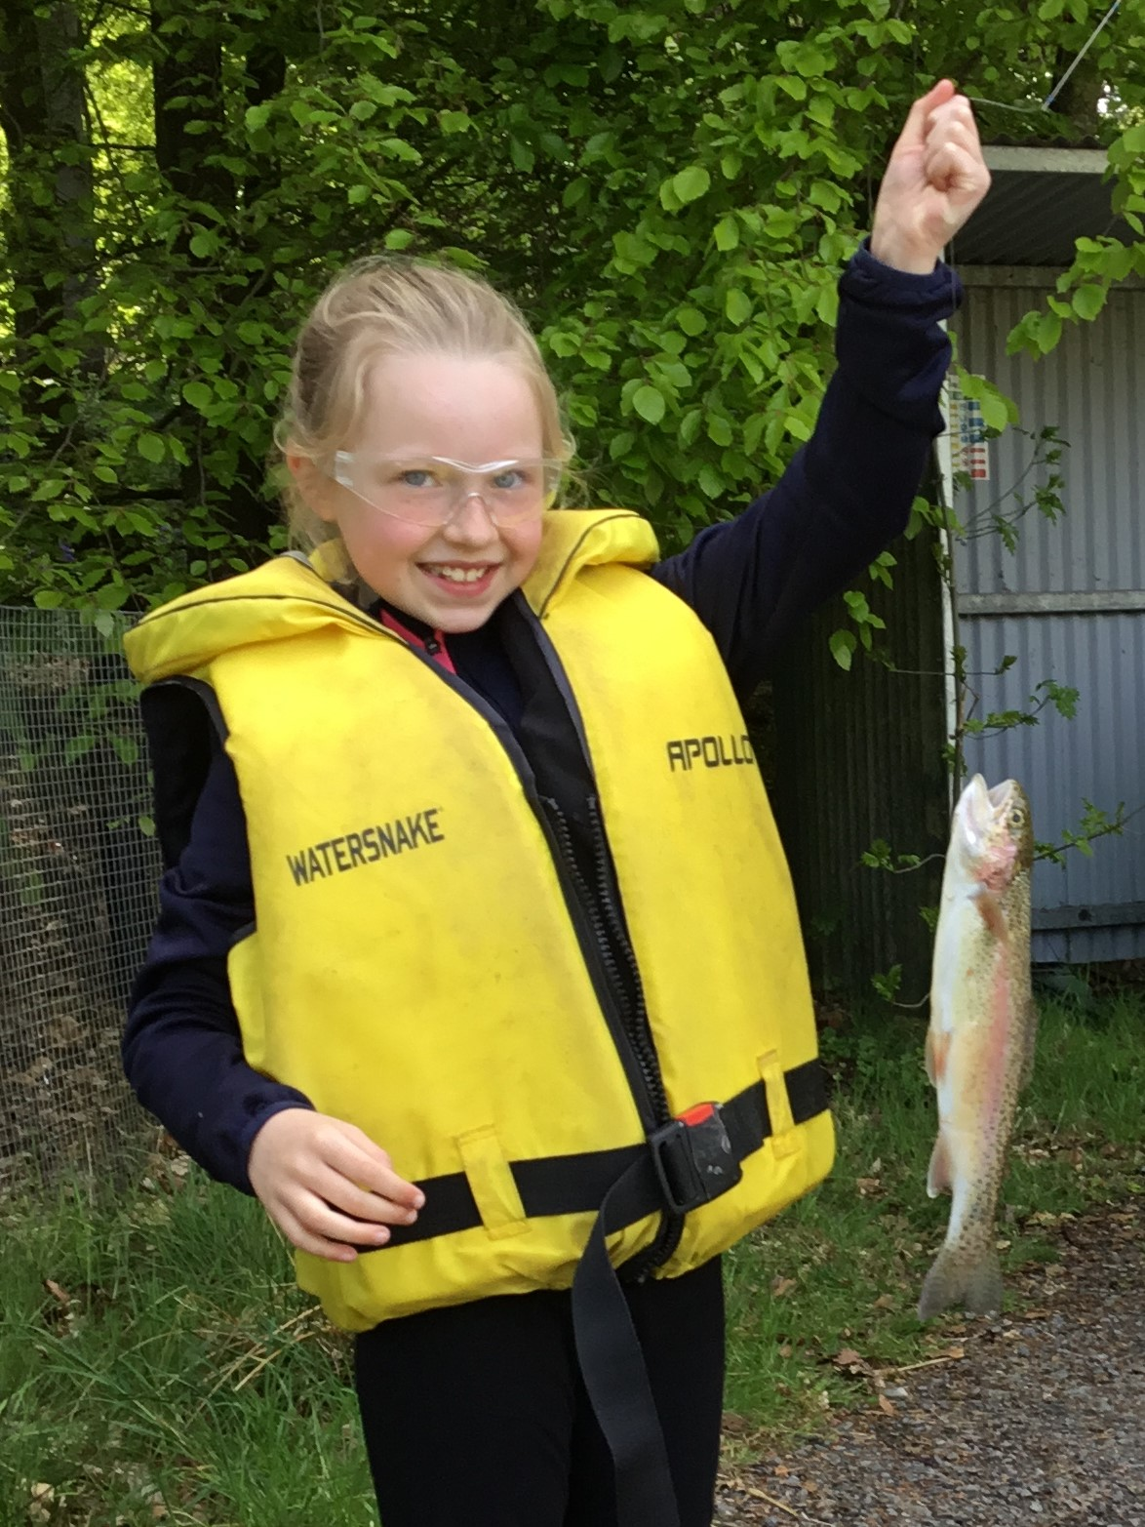

Slide 23
Thinking hard…

Slide 24
..and learning in so many different ways.

Slide 25
Working as a team is a good idea.
But no fighting please...

Slide 29
Being creative.

Slide 31
Did the sun always shine on us?

Slide 32
Seems like it!

Slide 33
It did in Slieve Gullion!
June 2019

Slide 37
With our Roots of Empathy teacher!

Slide 38
Dressing Up…

Slide 39
We went out and about.

Slide 40
Every little helps!

Slide 41
Sometimes we just worked in class.

Slide 45
Writing with the Author Ed Vere in P4

Slide 46
There was time to dance… go boys!

Slide 47
And to enjoy Shared Education activities….

Slide 51
Achievement comes….
..in many forms.

Slide 53
Head Girl, Head Boy and their Deputies 2019 - 2020

Slide 54
Prefects: Term 1 and Term 2

Slide 55
Chairperson of the School Council
2019-20
Anti-Bullying Ambassadors
2018-2020

Slide 58
Cousins!

Slide 59
Twins!

Slide 60
October 2018 Primary 6

Slide 61
June 2019 – New Grange

Slide 62
Christmas 2019

Slide 64
Thumbs Up for the Class of 2020!

Slide 65
Goodbye and Good Luck!

